Slide 1


Review-II
DESIGN AND SIMULATION OF RADIO-OVER-FIBER(ROF) SYSTEM FOR 5G BACKHAUL 6G TERAHERTZ EXTENSIONS USING OPTISYSTEM
AY 2025-26
Capstone Project – Introduction (PROJ2999)
GITAM (Deemed-to-be) University
Project Team:
BHARATH S R
GAGANESH S R
Project Mentor:
SUBHASHISH TIWARI
Project In-charge:
JAYA PRAKASH SAHOO
Department of Electrical Electronics and Communication Engineering
www.gitam.edu

Slide 2
Objective and Goals
Objective:
To design and simulate a Radio-over-Fiber system for 5G backhaul using OptiSystem.
Goals Achieved:
Complete System Design: Modeled the full RoF link in OptiSystem.
6G Signal Generation: Successfully implemented Optical Heterodyning to generate a 100 GHz carrier.
Optical Transmission: Validated signal propagation over a 25 km Single Mode Fiber (SMF).
Demodulation Stage: Designed the receiver circuit with Local Oscillator and Filtering.

Slide 3
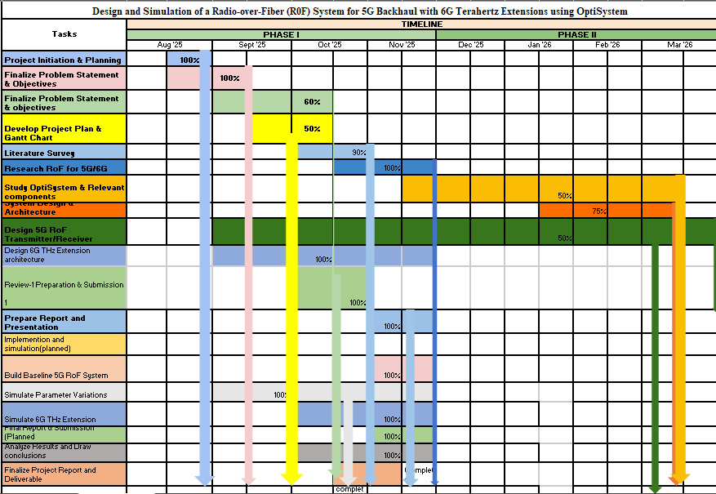
Project Plan
Gantt Chart - Milestones and Activities
Activity | Status
Literature Survey & Problem Definition | Completed
OptiSystem Architecture Design | Completed (Current Stage)
100 GHz Carrier Generation (Heterodyning) | Completed (Current Stage)
25 km Fiber Transmission Test | Completed (Current Stage)
QAM Modulation Comparison (64 vs 256) | Pending (Next Phase)
Final Performance Analysis (BER/EVM) | Pending (Next Phase)

Slide 4
Literature Survey
Key Publications:
1 M. R. H. Khan, et al., "Integrated Solutions for Deployment of 6G Mobile Networks," in 2022 IEEE 95th Vehicular Technology Conference: (VTC2022-Spring), 2022.
2 Keysight Technologies, "Breakthrough in Ultra High-Speed Wireless Backhaul Paves the Way for 5G and 6G Connectivity," June 2025.
3 S. M. R. Islam, et al., "Radio- and Power-over-Fiber Integration for 6G Networks: Challenges and Future Prospects," IEEE Access, vol. 12, pp. 1-26, 2024.
4 M. A. B. Abbasi, et al., "A Comprehensive Review on Radio over Fiber Systems for Capacity Enhancement," International Journal of Engineering Research & Technology, vol. 11, no. 12, 2022.
5 H. Shams, et al., "Simultaneous 5G and 6G THz over a Single Wavelength Radio-over-Fibre Distributed Antenna System," Electronics, vol. 12, no. 1, p. 64, 2023.
6 A. Kumar, et al., "An Investigation of Radio over Fiber (RoF) Communication System Technology: A Review," International Journal of Electronics and Communication Engineering, vol. 11, no. 1, pp. 1-10, 2024.
Key Resources:
Software: Optiwave Systems Inc. OptiSystem 17 is used for its comprehensive optical and RF component libraries.
Existing Implementations:
The literature confirms that RoF is a mature candidate technology for 5G backhaul applications.
Photonic THz generation is identified as a strong potential technique for 6G systems.

Slide 5




System Design Architecture
Optical Transmitter
Optical Fiber Link
Optical Receiver
Laser diode, RF signal generator, optical modulator, and bias control circuits
Single-mode fiber with specified length, dispersion compensation, and optical amplifiers
Photodiode, electrical amplifier, RF filter, and signal recovery circuits

Slide 6
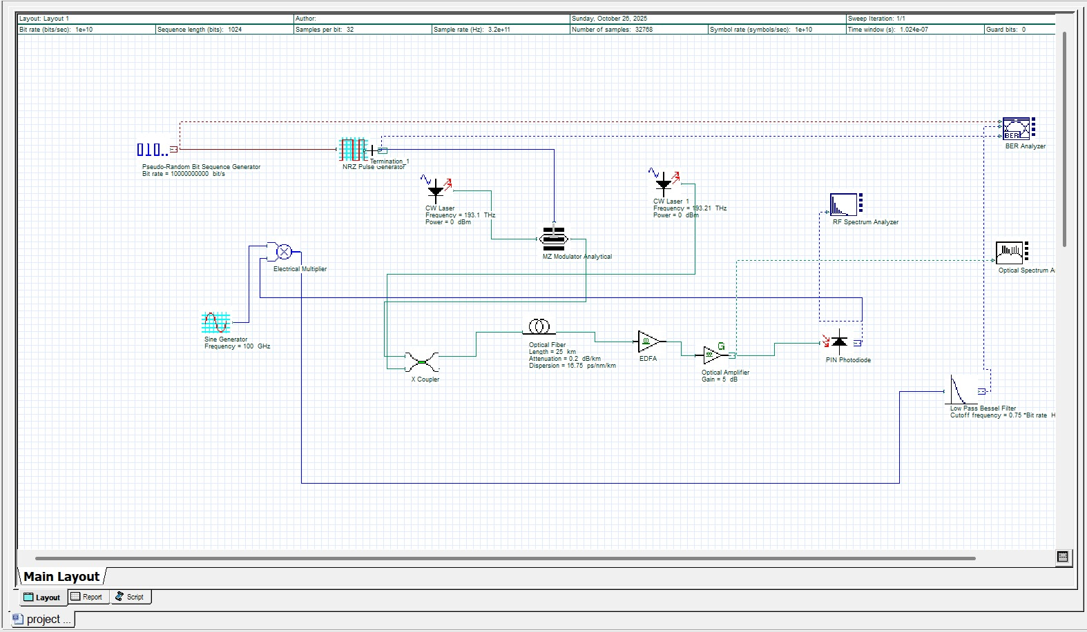
Architecture
Transmitter:
Data: 10 Gbps PRBS source.
Optical Source: Two CW Lasers (193.1 THz & ~193.2 THz) combined via X-Coupler.
Channel:
Fiber: 25 km SMF (Attenuation: 0.2 dB/km).
Amplifiers: EDFA + Optical Amplifier (5 dB Gain) to offset fiber loss.
Receiver:
PIN Photodiode: Performs the heterodyne mixing.
Demodulator: Electrical Multiplier + 100 GHz Sine Generator + Low Pass Filter.

Slide 7
Use Cases & Testing
Real-World Use Cases
5G/6G Mobile Backhaul:
Simulates a "Centralized-RAN" architecture where a Central Station connects to Remote Towers over standard fiber distances (Metro Area Network).
Benefit: Eliminates the need for complex, power-hungry electronic oscillators at every remote tower.
High-Speed Campus/Indoor Networks:
Distributing 100 GHz (Sub-THz) signals to remote antenna units for ultra-fast wireless coverage in stadiums, airports, or server rooms.
Secure & Cost-Effective Fronthaul:
Centralizes all signal processing at the main office, reducing the cost and maintenance of remote base stations.

Slide 8

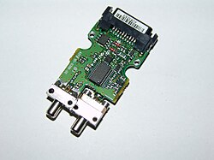
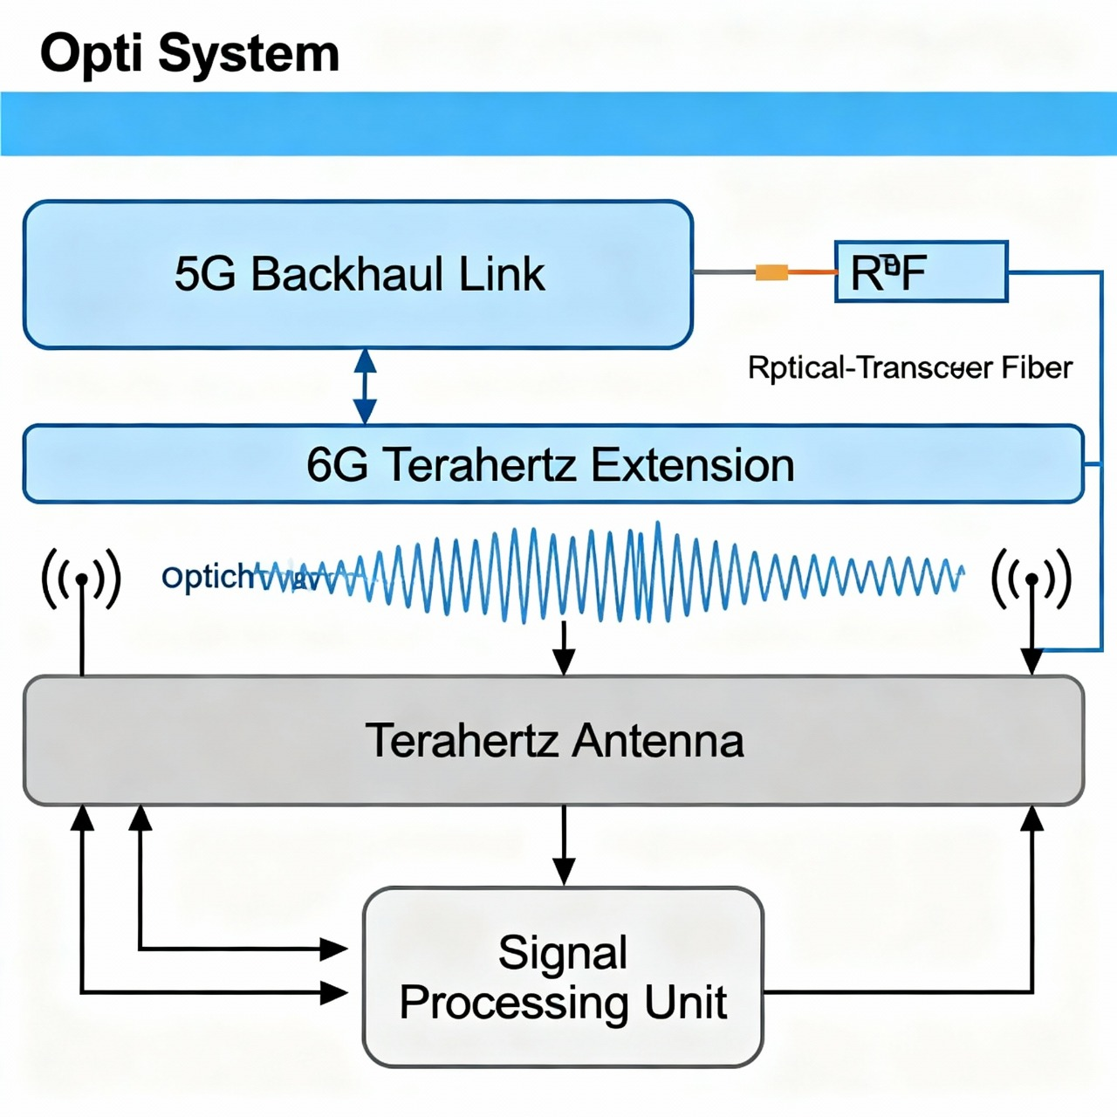
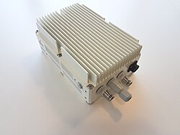

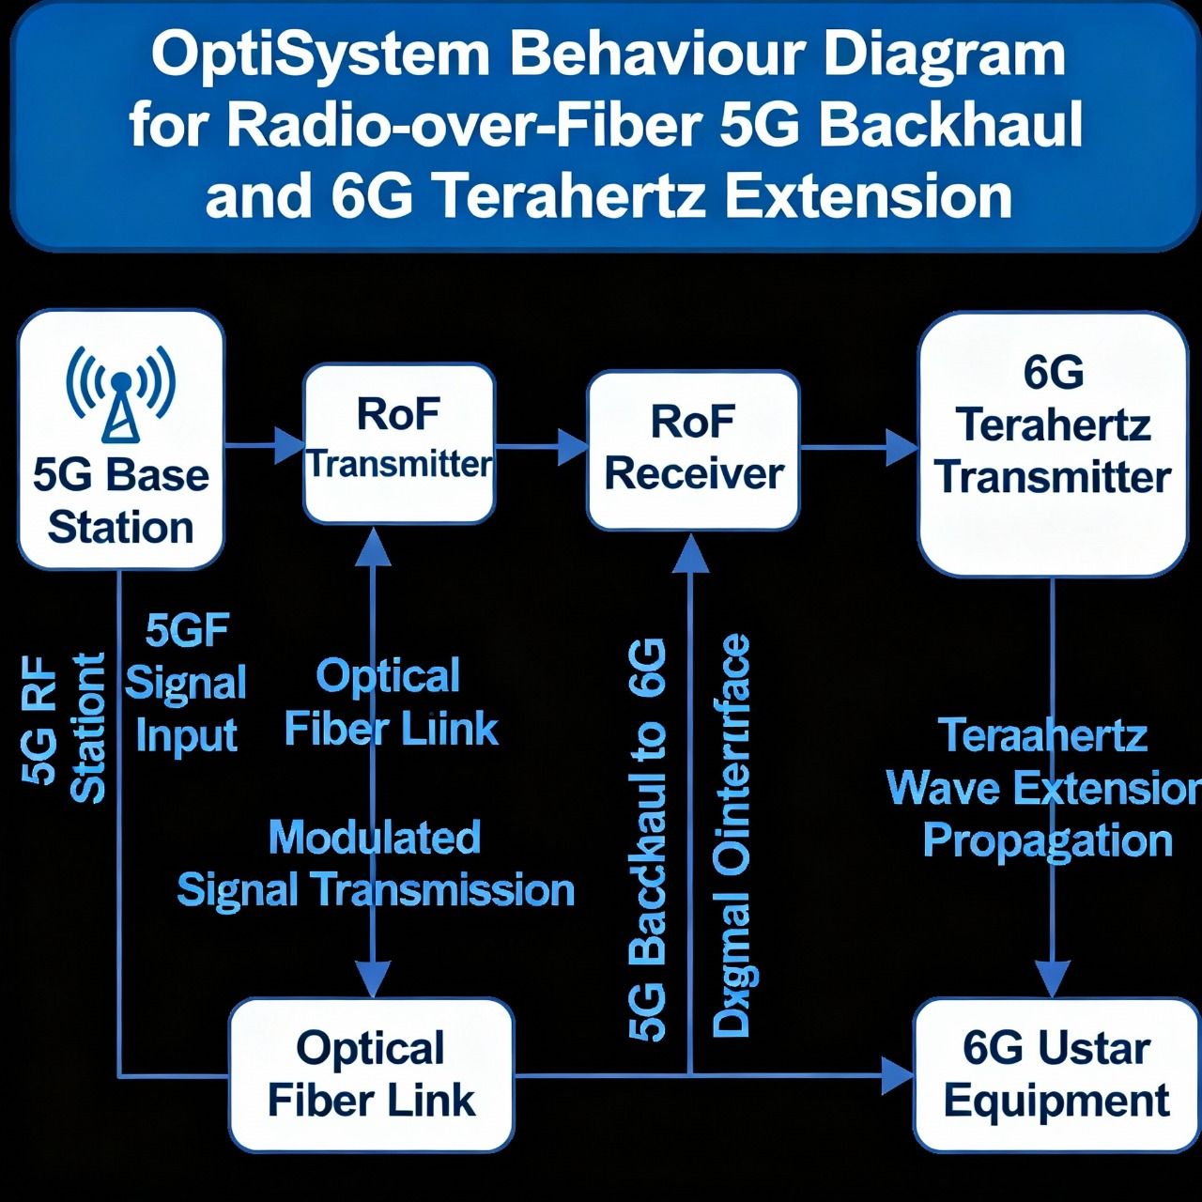
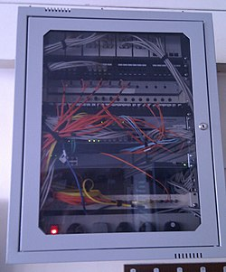

Diagrams

Slide 9
Testing Methodologies
Simulation Test Cases
Test Case 1: Photonic Carrier Generation (Validated)
Objective: Generate a 6G-capable carrier frequency using only optical components.
Setup: Optical Heterodyning of Laser 1 (193.1 THz) and Laser 2 (193.2 THz).
Result: Validated via RF Spectrum Analyzer showing a distinct 100 GHz spike.
Test Case 2: Optical Link Transmission (Validated)
Objective: Verify signal propagation and power levels over metro distances.
Setup: 10 Gbps data transmission over 25 km Single Mode Fiber.
Result: Validated via Optical Spectrum Analyzer; signal power remains sufficiently above the noise floor.
Test Case 3: Demodulation Logic (Designed)
Objective: Recover the original baseband data from the high-frequency carrier.
Setup: Implementation of PIN Photodiode - Electrical Multiplier - Low Pass Filter.
Status: Circuit completed; ready for Bit Error Rate (BER) analysis in the next phase.

Slide 10
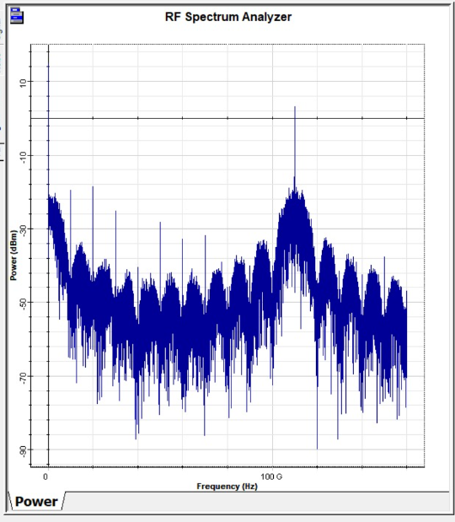
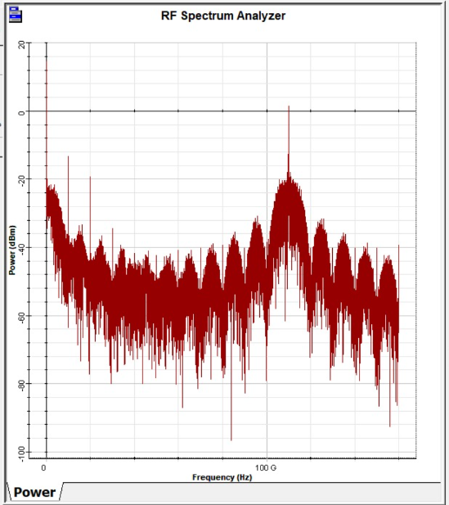
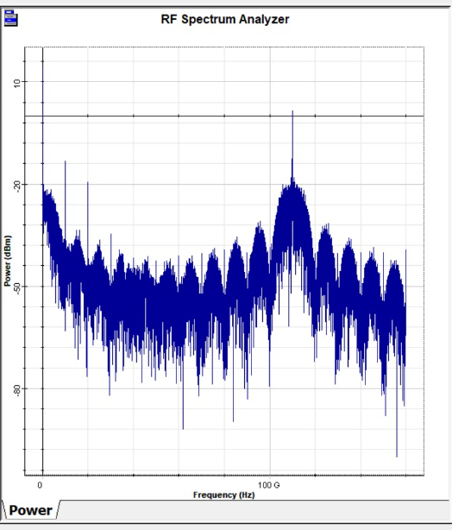
Implementation and Results – Iteration 1
Analysis:
The RF Spectrum Analyzer connected to the PIN Photodiode shows a distinct power spike at 100 GHz.
Conclusion:
The Optical Heterodyning technique is functioning correctly.
We have successfully generated a millimeter-wave carrier suitable for 6G wireless extension using only optical components.
RF Spectrum Analyzer Results

Slide 11
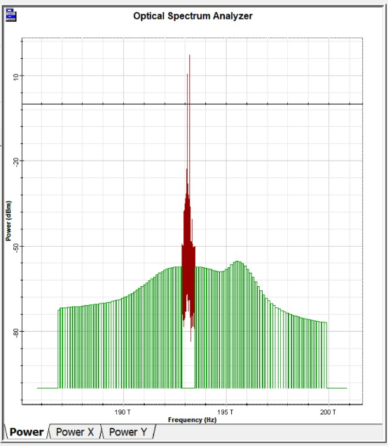
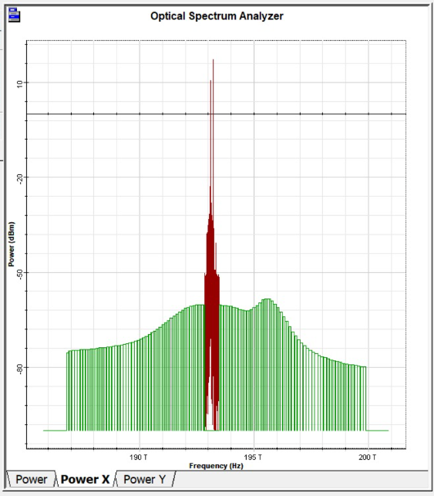
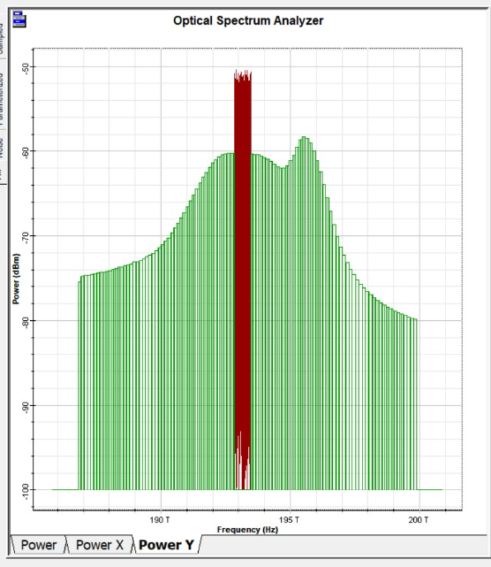
Implementation and Results – Iteration 2
Analysis:
The graph displays the optical carrier peak along with the modulation sidebands.
The green "floor" represents the Amplified Spontaneous Emission (ASE) noise introduced by the EDFA.
Conclusion:
The signal has successfully traversed the 25 km fiber link.
Signal power is maintained sufficiently above the noise floor for detection.
Optical Spectrum (Transmission) Results

Slide 12
Conclusion & Future Work
Conclusion
Design Validated: The proposed RoF architecture for 5G/6G backhaul has been successfully modeled in OptiSystem.
Technology Proven: Photonic generation of high-frequency (100 GHz) signals was verified via spectrum analysis.
Link Established: Optical transmission over 25 km has been achieved with confirmed signal presence at the receiver.
Future Work (For Next Phase)
Performance Metrics: Execute BER analysis to obtain Q-Factor and Eye Diagrams for the current 25 km link.
Modulation Upgrade: Implement OFDM-QAM (64-QAM and 256-QAM) to improve spectral efficiency.
Stress Testing: Increase fiber length to 40 km and analyze the degradation in signal quality.
Final Report: Compile comparison data between modulation schemes.

Slide 13
THANK YOU
Have a Great Day !

